Slide 1
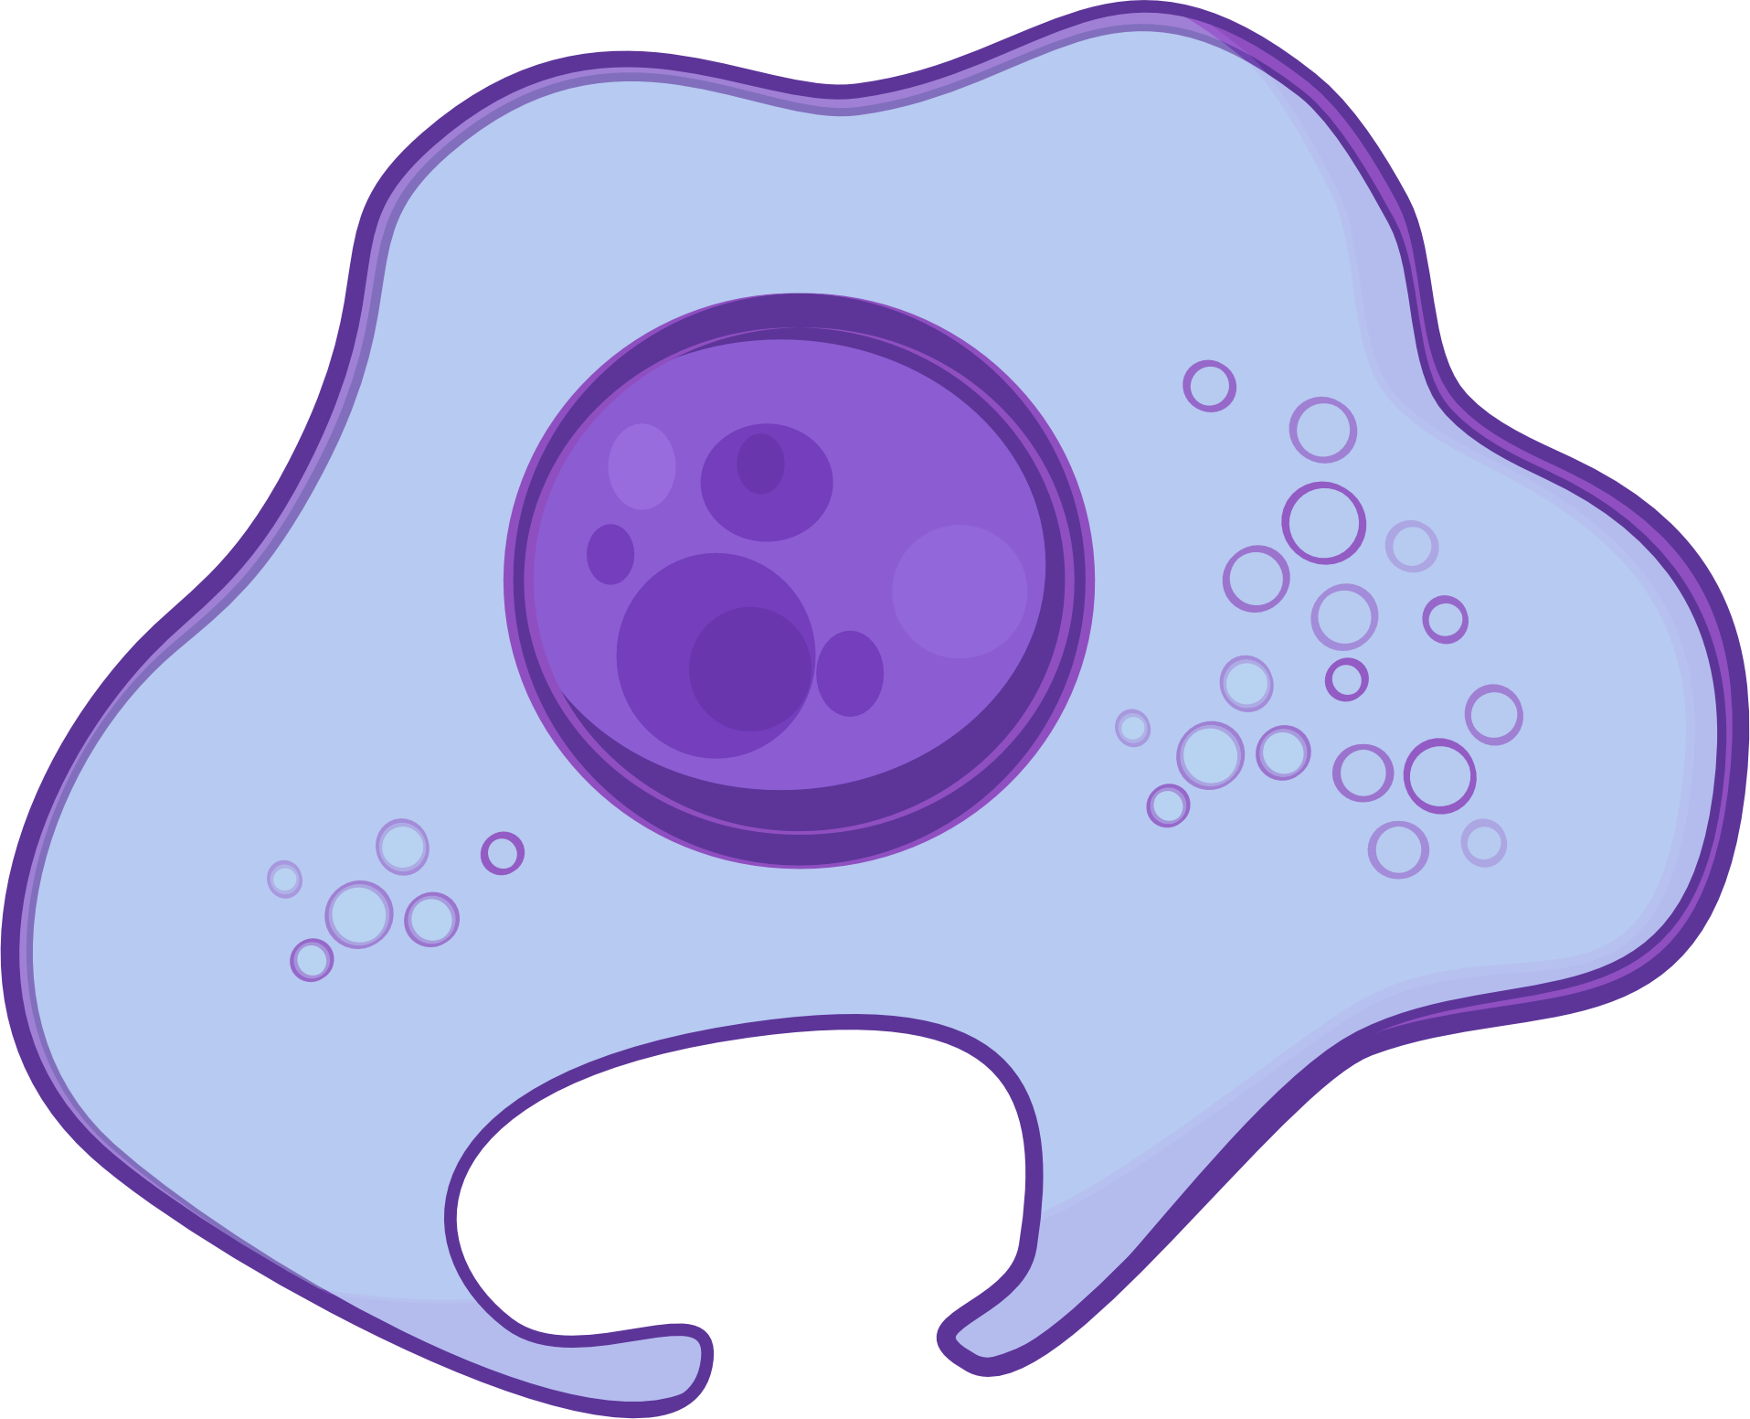
Modalities
(Gene Expression, Chromatin Accessibility, etc.)
Collaborative Reinforcement Learning Environment
Development and Disease Trajectory Reconstruction
?
Cells
Perturbation Analysis and Feature Prioritization
?
Features
(Genes, Chromatin Regions, etc.)

